Slide 1
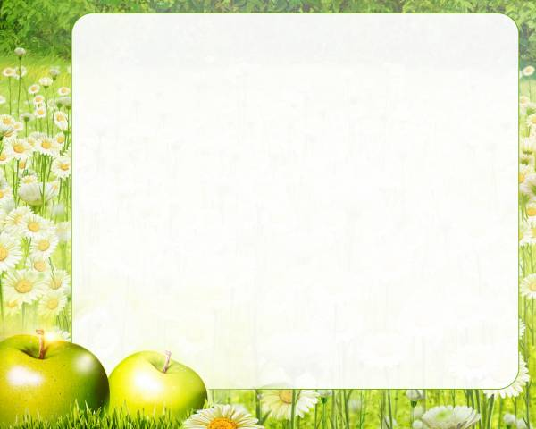
Our health is
the best wealth
Підготувала
вчитель англійської мови Приймак Ніна Василівна

Slide 2
Aim
To make acquainted with new words about “ Health problem”
To develop auditory skills;
To develop reading, speaking and writing skills;
To give the information about health problem in our country
To cultivate the wish of leading a healthy way of life.

Slide 3
Advice
You are smart and creative pupil
Be active!
2. Don’t afraid to make mistakes

Slide 4


Today I ‘ll tell you about health problems.
Hello!
I am Doctor Health. I am from Ukraine. I love my country. And where are you from? Do you like your Motherland?

Slide 5
New vocabulary
Ache
Headache
Earache
Toothache
Backache
Sore throat
Pain
To hurt
To suffer from
Allergy
Asthma
Depression
Diabetes

Slide 6
Find the spelling mistakes
Headace
Astma
Sor throat
Allergi
diabet
Sufer from
Tothache
Pein
Bakache
achee

Slide 7
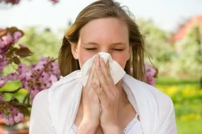
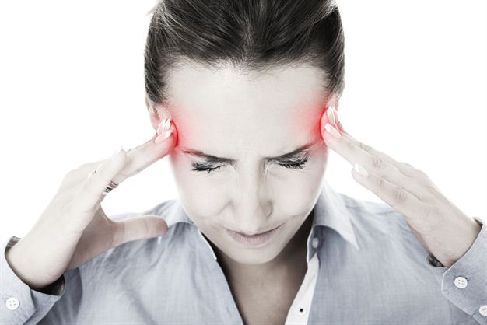
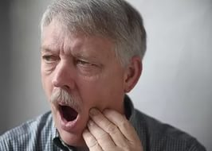
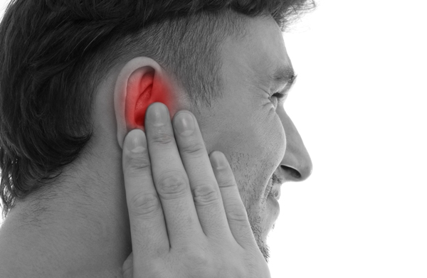
He /She suffers from …

Slide 8
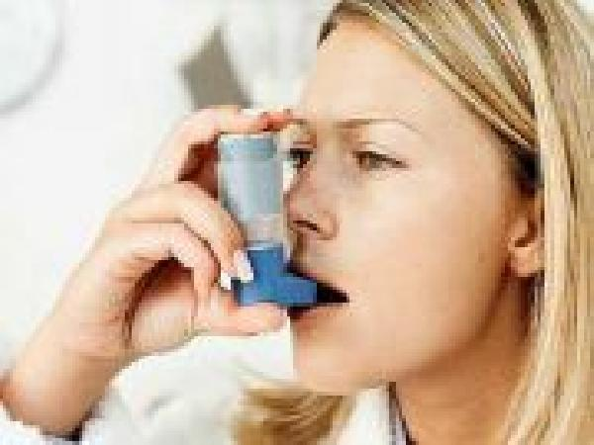
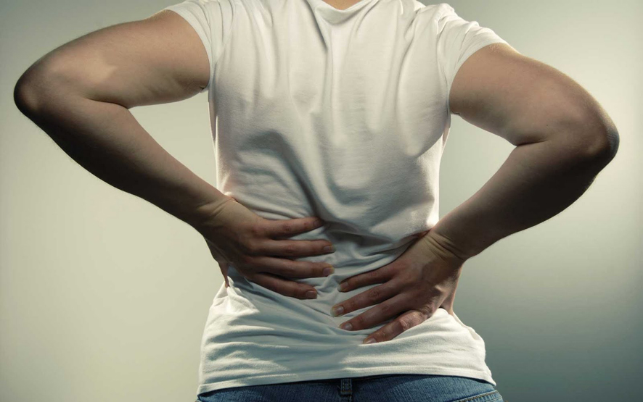
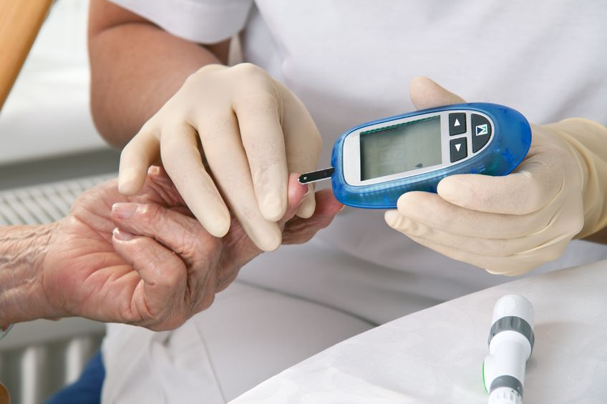
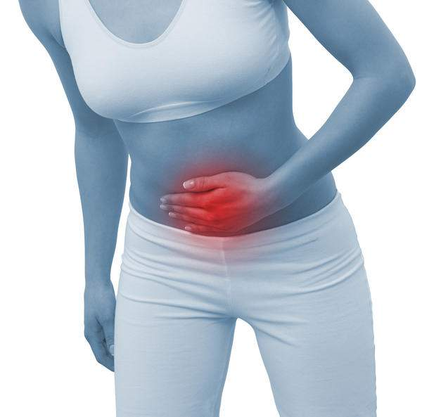
He/she has got a ….

Slide 9
What disease can be connected with…
a)grass, flower?
b) smoking?
c) a lot of eating sweets?
d)some problems with family, money?
e)pollution, traffic fumes?
f) cold drinks, a lot of ice-cream?
g) cold weather?
I think, It can be a / an ….

Slide 10
This desease is
Not serious | More serious | Very serious
not serious | more serious | very serious
Headache | allergy | Diabetes
toothache | stomachache | asthma
sore throat | depression
earache

Slide 11
Read and guess
What disease have my patients got?

Slide 12
And now, please write, about you and your health problem

Slide 13
Listen and guess

Slide 14
Homework
Ex. 5, p.110

Slide 15
Список використаних джерел:
http://www.wikihow.com/Become-a-Very-Healthy-Person
http://www.wholeliving.com/136136/50-simple-health-tips#26815
http://health.proverbs.tel/
http://parade.condenast.com/232086/sverve/5-healthy-habits-for-you-your-family-holiday-edition/

